Slide 1
COMP 3400
Week 13 – Wednesday

Slide 2
Last time
What did we talk about last time?
Limits of parallelism
Amdahl's Law
Gustafson's Law
Timing in distributed environments
Clock synchronization
Lamport timestamps
Vector clocks

Slide 3
Questions?

Slide 4
Assignment 7

Slide 5
Reliable Storage and Location

Slide 6
Reliable data storage
If you want to get a file from a web server, you can go to a URL and make an HTTP request
Unfortunately, if that server is down or unreachable, you can't get the file
For this reason, distributed systems are often used to store data
A key feature of distributed data storage is replication, keeping multiple copies of the same data
Replication avoids a single point of failure
If done correctly, replication can also do load balancing, improving performance by providing multiple sources for data

Slide 7
Google File System
The Google File System (GFS) is a distributed storage system
GFS was designed to store Google's internal data, like the data structures used for PageRank
Files are often large, so they're broken into chunks
Chunks are stored on chunkservers as regular files
A master server stores a table mapping file chunks to their locations

Slide 8
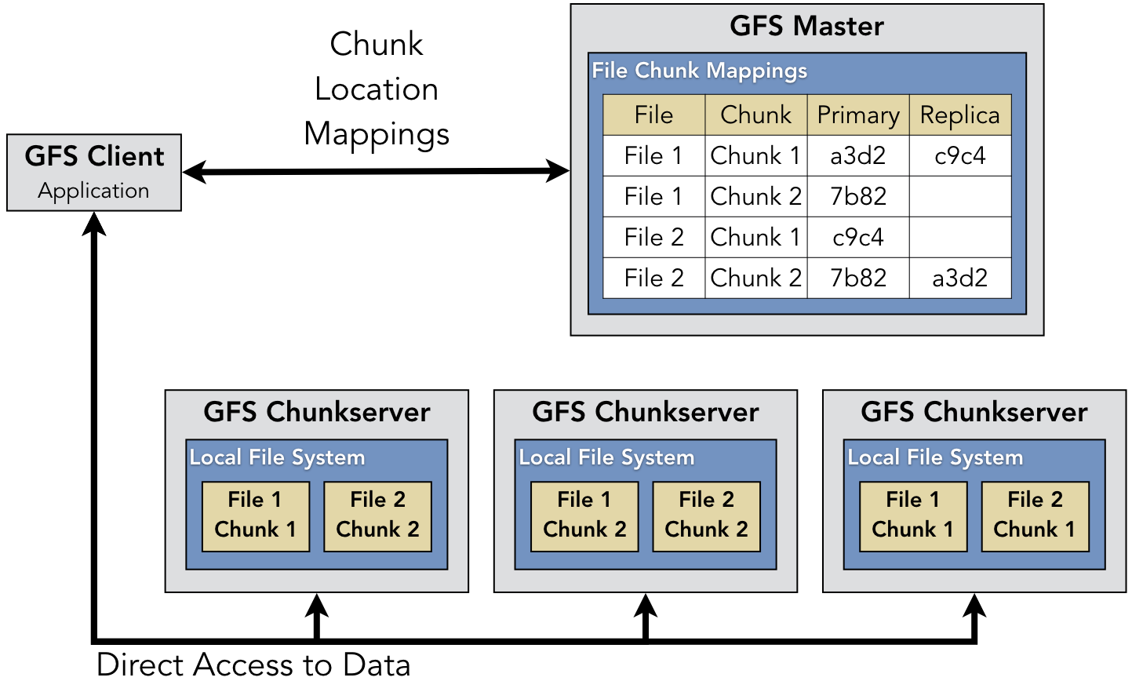
Illustration of GFS
Each chunk has a primary chunkserver as well as replicas
The chunks are identical, but the primary chunkserver is the only place where the chunk can be modified
It propagates changes to the other chunkservers
This redundancy makes writing to GFS slower, even though reading is relatively fast
The master server periodically sends messages to the chunkservers to get their current status

Slide 9
Distributed hash tables
GFS was designed by Google for its own purposes
It uses a central server
Servers keep information about each other
What if we have no idea what servers are going to be in the network?
Distributed hash tables (DHT) are an approach for mapping arbitrary objects to arbitrary servers
DHTs are a way to organize a peer-to-peer network to avoid query flooding

Slide 10
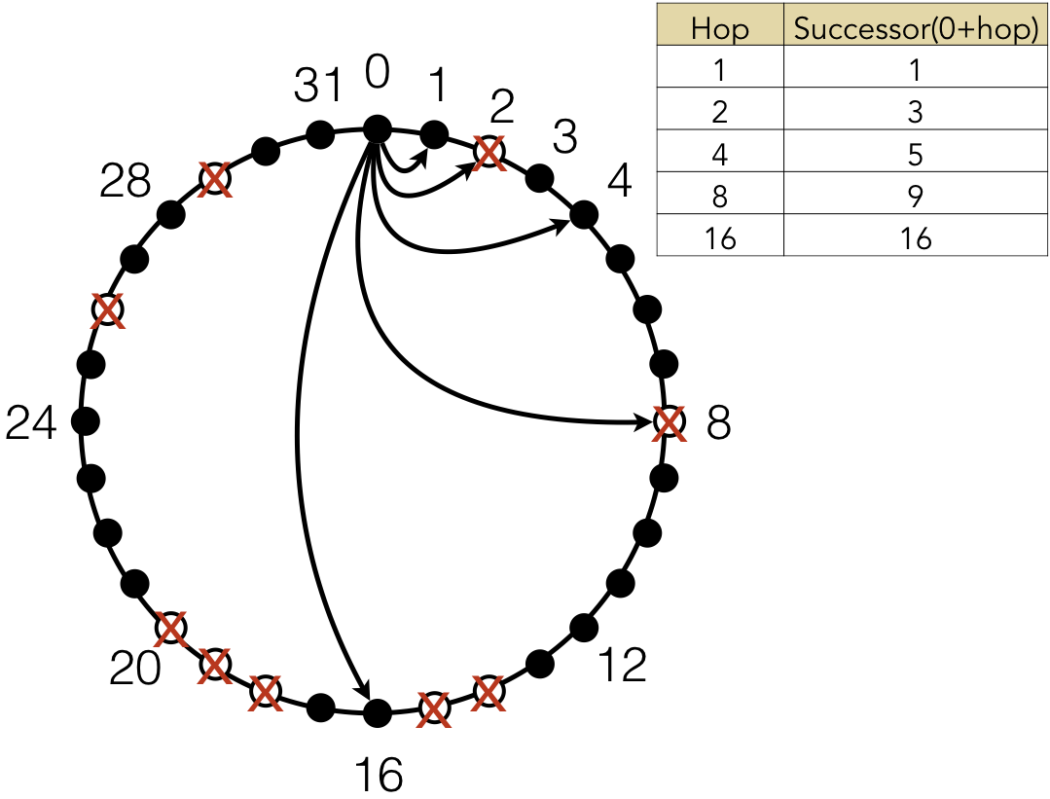
Chord DHT
Chord was one of the first algorithms for a DHT, introduced in 2001
Each node has a unique identifier (often its IP address) that's hashed to provide a location in a circle
If the hash is n bits long, the DHT can support up to 2^{n} nodes
Most locations in the circle are empty
Each node has a "finger table," tracking successor elements in increasing powers of 2 away on the circle
If the power of 2 node is missing, it tracks the next non-missing node
The example on the right is only for 2⁵ = 32 nodes

Slide 11
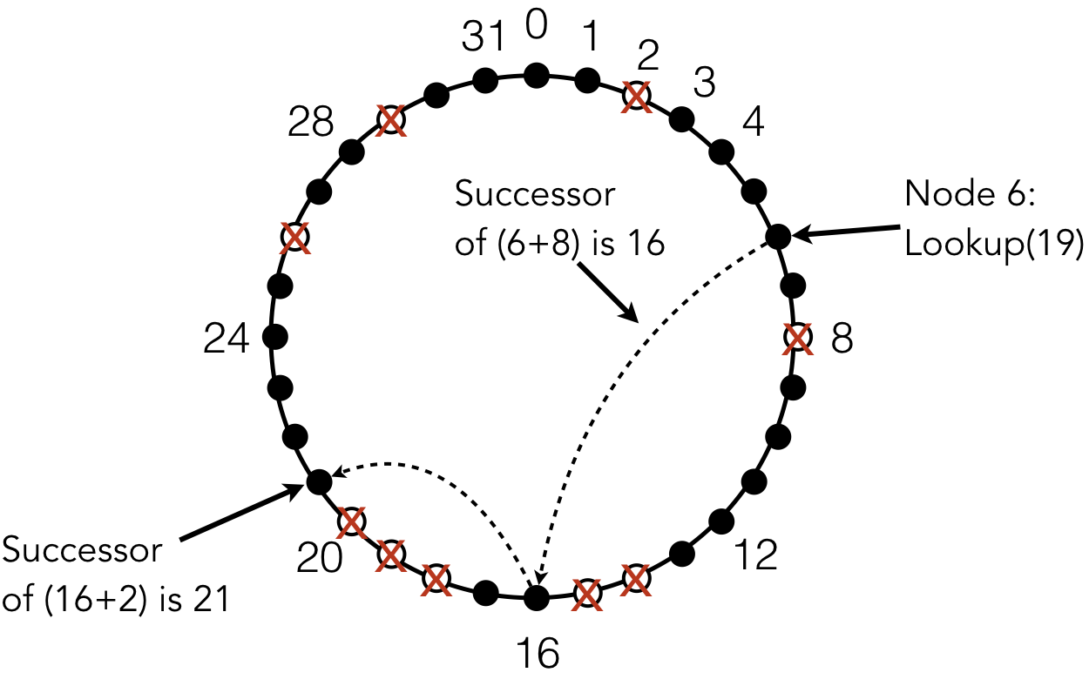
Files in Chord DHT
When a file is added, it's hashed
Whichever node has that hash value (or is its successor) is the location of that file
On the right, node 6 is looking for a file at location 19 (the successor of 18)
It looks at 6 + 8 = 14, which doesn't exist but has a successor of 16
Then it looks at 16 + 2 = 18, which doesn't exist but has a successor of 21
Node 21 is where the file is supposed to be
The details get a little more complex, but the practical result is that a file can be found with O(log n) requests, where n is the size of the network
Replication is done by caching files at nodes that were part of the lookup to find the file

Slide 12
Consensus in Distributed Systems

Slide 13
State machines
At a high level, you can think of distributed systems as state machines
The system contains many variables with different values that change over time
The idea is broader than a finite state machine, since the system is more complex than having a single state
In a distributed system, different nodes could have different internal representations of these values
If the nodes agree on a state variable's value, they have consensus

Slide 14
Consensus
Reaching consensus is the goal of many distributed protocols
To reach consensus, a protocol must have three properties:
Termination: Every correct (non-failing) process will eventually decide on a value
Integrity: If every correct process proposes the same value, any correct process must decide that value
Agreement: All correct processes decide the same value
Examples
In GFS, a consensus protocol could tell any node whether a particular file was on a particular node
In NTP, nodes will be able to agree on synchronized time

Slide 15
Failure
However, processes do fail in distributed systems
Failure could mean making some error, crashing, going into an infinite loop, or losing connection to the network
Processes could even be malicious, trying to undermine the system
Even in the face of (many?) failures, we'd like the distributed system to reach consensus
A common analogy used to describe this problem is the Byzantine generals problem

Slide 16
Byzantine generals
The Byzantine generals problem imagines three generals stationed around a large city
Only if all three generals decide to attack, they can defeat the city
If all three generals decide to retreat, they can retreat with minimal casualties
But if some attack and some retreat, they're all going to get slaughtered
The generals exchange messages with each other to see what they want to do
What if one general tells A that he's going to retreat and B that he's going to attack?
A will decide to retreat but B will go ahead and attack

Slide 17
More on Byzantine generals
A different (but equivalent) version of the Byzantine generals problem imagines:
One general is the commander who decides what to do
The other two are lieutenants who check with each other to make sure that they got the same message from the commander
What if there's one bad general?
A bad commander could send retreat to one lieutenant and attack to the other
A bad lieutenant could receive attack from the commander but send retreat to the other lieutenant
A good lieutenant couldn't distinguish between those two situations

Slide 18
Limits on consensus
Consensus is hard
Failing processes can mess things up for correct processes
Because there's limited information, a process can appear to be correct to one part of the system and failing to another
A Byzantine failure is exactly this kind
There's conflicting information, and it's impossible to determine what's reliable

Slide 19
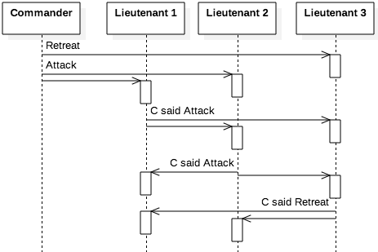
The 1/3 limit
It's not an accident that the number of generals chosen is three
If strictly less than 1/3 of the nodes are failing, it's possible to achieve consensus
If we extend the problem to four generals (three lieutenants), then generals who are working can decide on a consensus using majority rule
Even a bad commander who issues confusing orders won't mess up the system
However, knowing what the consensus is doesn't tell us which nodes are failing
Also, this 1/3 limit depends on synchronous communication

Slide 20
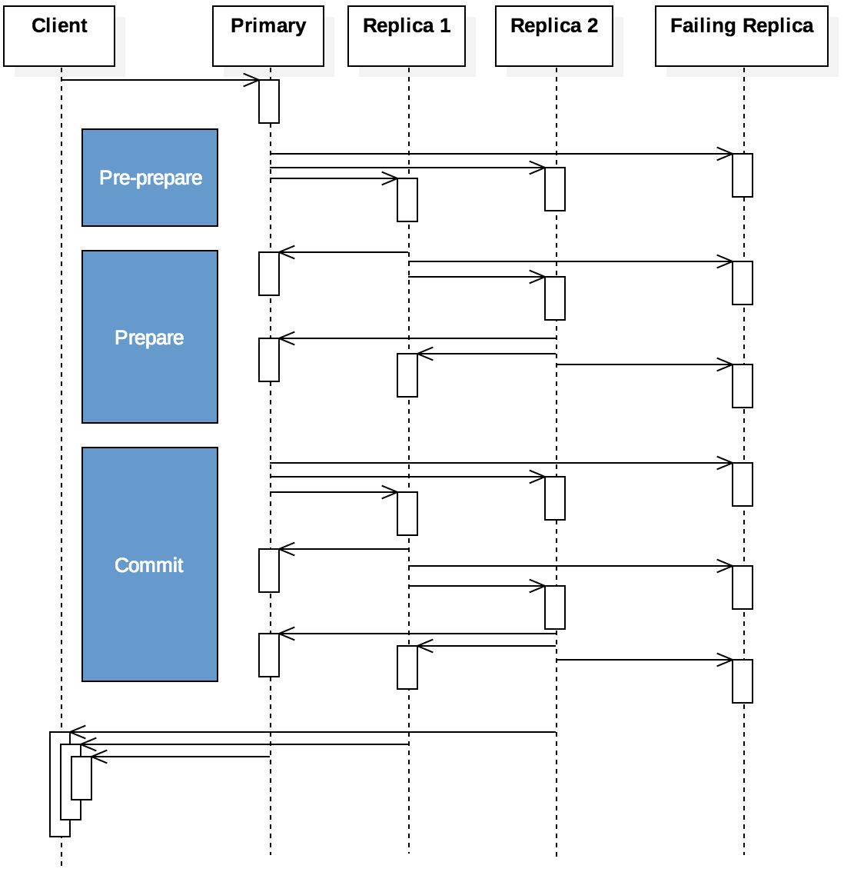
Practical Byzantine fault tolerance
Consensus is a pretty high bar
Practical Byzantine fault tolerance (PBFT) tries to make a workable system with consistency among nodes without requiring consensus
A client asks a primary process for some data
The primary process asks replicas for the data
The client considers the majority response to be correct after getting enough responses
It works because
Messages are cryptographically signed
Messages are numbered so that old messages won't be reused
Responses have a time limit
We assume that less than 1/3 of the processes are faulty, meaning that if we get messages from more than 1/3 of the processes that agree, we assume the response is good

Slide 21
Blockchains

Slide 22
Blockchains
Blockchains are a form of distributed ledger
Unlike banks, which are centralized authorities for transactions that have occurred at the banks, blockchains try to record transactions in a distributed way with no central authority
Although similar ideas existed before, blockchains as we know them were invented by Satoshi Nakamoto (real identity unknown) in 2008
The original blockchain idea was intended to keep track of bitcoin transactions
Now, most cryptocurrencies use some form of blockchain to track transactions

Slide 23
Double-spending
Blockchains are distributed systems that can be used to record almost anything
But their use has been dominated by cryptocurrency
A central problem that any digital money faces is double-spending
What stops someone from spending a digital token more than once?
Transactions are recorded in blockchains
Two competing blockchains could record different transactions, but the longer chain is considered the valid one

Slide 24
Proof-of-work
Blockchains are built by recording transactions along with other data that hashes in a specified pattern
Usually, a hash value with a certain number of zeroes at the beginning
It's easy to check that the transaction has the right hash value
But it's computationally difficult to generate data that has a hash with a certain number of zeroes at the beginning
And that's what mining is: Trying random strings until something has the right hash value
Since a large number of strings will have the right hash value, an entity with more than 50% of the computational power working on a blockchain network could outpace everyone else writing transactions, taking control of it

Slide 25
Why blockchains?
Blockchains are trying to solve the same problem we talked about with Byzantine generals: consensus
However, the goal isn't to retrieve data efficiently
The goal is to make a record that's hard to dispute
Even if there are malicious actors who want to lie about the transactions
Block time is how long it takes for the network to add a block, recording a set of transactions
About 12 seconds in Ethereum
About 10 minutes in Bitcoin
Blockchains can also be used to record ownership of digital items
Like the non-fungible tokens (NFTs) that people went crazy over for a few months

Slide 26
Why not blockchains?
Most current blockchains use proof-of-work to show that the blocks are valid
Ethereum switched over to proof-of-stake, which is estimated to consume only 0.005% of the power needed by Bitcoin
Proof-of-work requires huge computational effort to find a string whose hash starts with enough zeroes
A 2024 review from the Institut Polytechnique de Paris estimates that Bitcoin mining uses about the same power as Poland
Best estimates suggest that a single Bitcoin transaction uses hundreds of thousands as times as much energy as a Visa transaction
Blockchains are often structured to require more computational effort when more people are mining
There's a real environmental cost as well as the use of electricity that could be used for practical things

Slide 27
Ticket Out the Door

Slide 28
Upcoming

Slide 29
Next time…
Review up to Exam 1

Slide 30
Reminders
Work on Assignment 7
Due Thursday before midnight!
No class on Friday!

